Slide 1
Apricots and Alcohol the facts…
98/365: Red, Red Wine [Image] (20.05.2009). Retrieved October 5, 2010, from http://www.flickr.com/photos/rogersmj/3549509993/

Slide 2
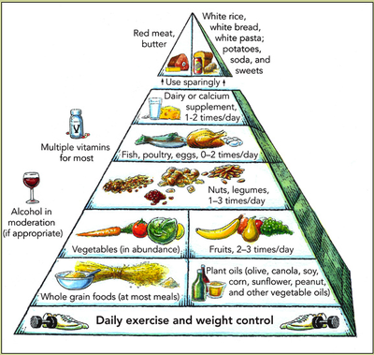
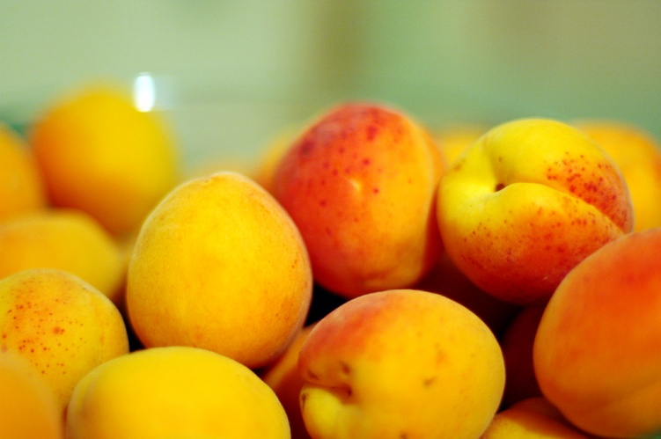
Apricots…
Where they fit in the food pyramid
The Harvard Food Pyramid [Image] (n.d.). Retrieved October 8, 2010, from http://www.hsph.harvard.edu/nutritionsource/what-should-you-eat/pyramid/index.html
Apricots are a fruit. It is recommended that we eat between 2 – 3 servings of fruit in a day
Apricots [Image] (13.07.2006). Retrieved October 8, 2010, from http://www.flickr.com/photos/84639318@N00/197275134
Notes:
Explain why we should eat fruit three times a day…

Slide 3
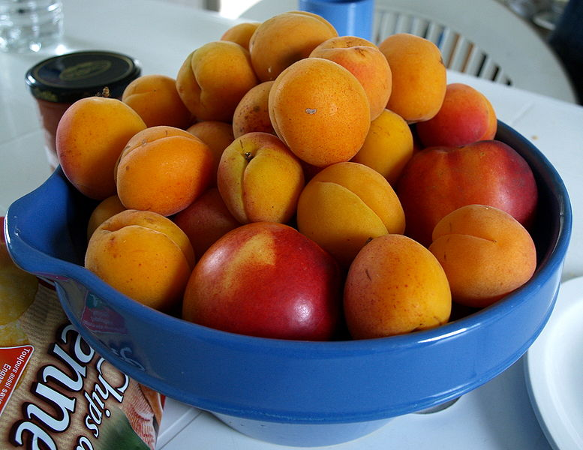
Apricots…
Apricots are very low in Saturated Fat, Cholesterol and Sodium. They are also a good source of Dietary Fiber and Potassium, and a very good source of Vitamin A and Vitamin C. We should remember that the sweetness of fruits comes from natural sugars. Although better than the sugars found in candy etc. they are still calories.
Abricots [Image] (13.07.2006). Retrieved October 8, 2010, from http://www.flickr.com/photos/84639318@N00/197275134
Notes:
Explain what each of these things means…(why do we want low saturated fat, cholesterol and sodium)

Slide 4
Alcohol
Where does alcohol fit in the food pyramid?
Etc…

